Slide 1



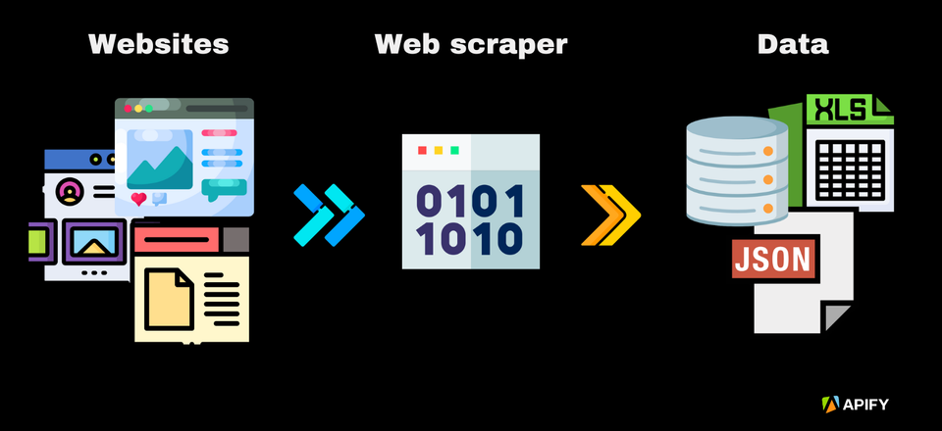
EVOASTRA
Web Scrapping: Data Extraction from WebPage
Presented by: Evoastra Team-D

Slide 2
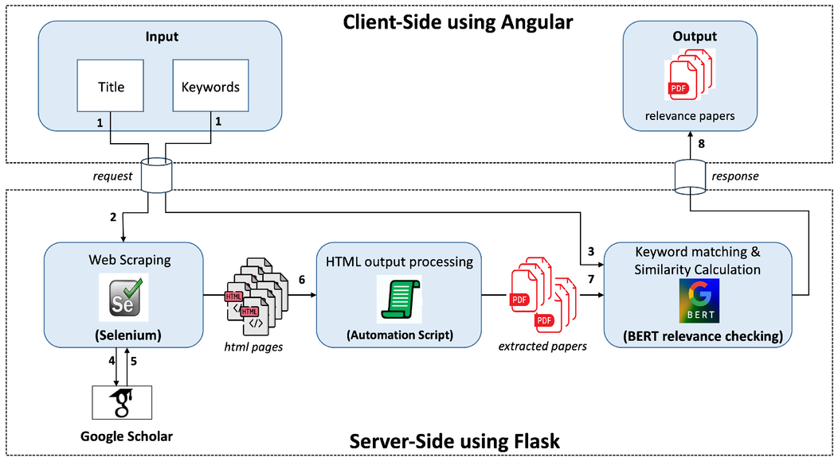
Introduction
EVOASTRA
Web scraping is the automated process of extracting data from websites using software. It transforms unstructured data on the web (HTML) into structured data (CSV, JSON, Database).
How it Works:
  Request: Script sends HTTP request to URL.
  Response: Server returns HTML content.
  Parse: Script navigates the DOM tree.
  Extract: Specific data points are saved.

Slide 3

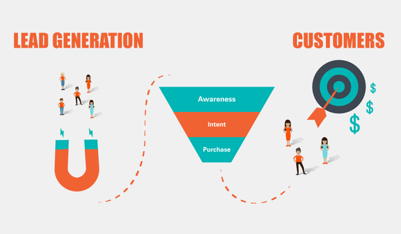

Real World Applications
EVOASTRA
  Market Research
Monitoring competitor pricing, analyzing market trends, and gathering sentiment analysis data from social media.
2. News Aggregation
Collecting headlines and articles from various news sources to build curated feeds or for financial analysis.
3. Lead Generation
Extracting contact details from business directories and listings to fuel sales pipelines and marketing campaigns.

Slide 4




Necessity
EVOASTRA
Why Use Web Scraping?
  Speed & Automation: Scripts can process thousands of pages in minutes, a task that would take humans days.
  Cost-Effective: Reduces the need for large manual data entry teams.
  Accuracy: Eliminates human error in data collection and entry.
  Real-Time Data: Enables access to the freshest data available on the web instantly.

Slide 5



Challenges & Risks
EVOASTRA
Legal & Ethical Issues: Not all websites allow scraping. Always check robots.txt and Terms of Service.
Anti-Scraping Measures: Websites implement IP bans, CAPTCHAs, and honey traps to block bots.
Structure Changes: If a website updates its HTML structure, the scraper will break and require maintenance.
Data Quality: Extracted data often requires significant cleaning and normalization.

Slide 6
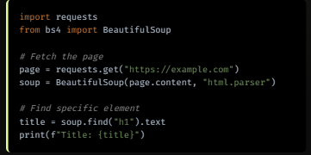
Static Scraping: BeautifulSoup
EVOASTRA
Parsing HTML
  BeautifulSoup is a Python library for pulling data out of HTML and XML files. It is perfect for static pages where data is present in the source code.
  It creates a parse tree that can be used to extract data easily.

Slide 7
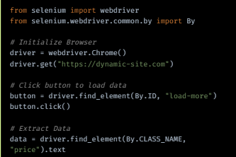
Dynamic Scraping: Selenium
EVOASTRA
Handling JavaScript
Selenium automates web browsers. It is essential for websites that load data dynamically using JavaScript (React, Angular, etc.).
Scrapy is another powerful framework for large-scale crawling, offering built-in support for handling requests, pipelines, and data export.

Slide 8
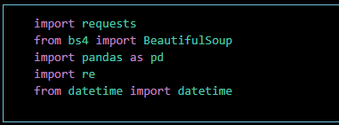
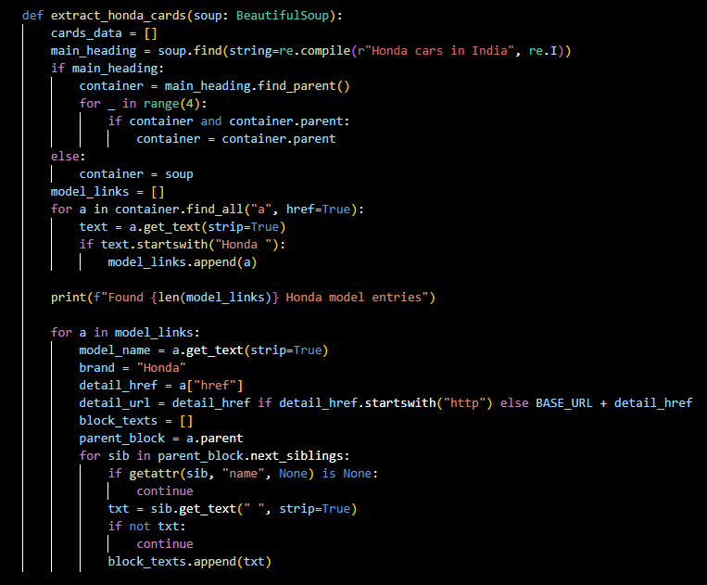
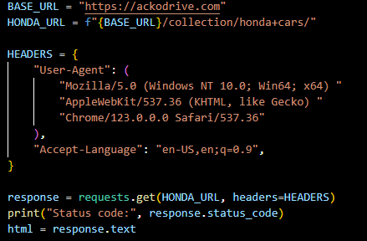
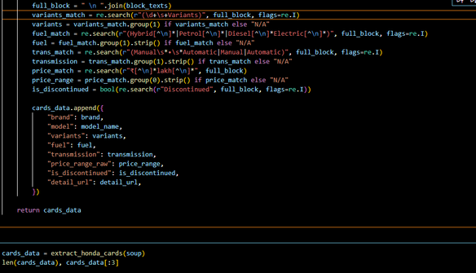

Code Implementation
EVOASTRA

Slide 9
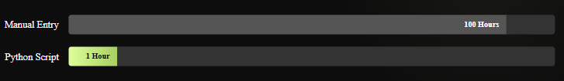

Results: Efficiency Comparison
EVOASTRA
Conclusion
Web scraping is a transformative skill for data-driven decision-making. While it offers immense speed and scalability, it must be performed responsibly, respecting legal boundaries and website resources.

Slide 10
EVOASTRA
Thank you!

